Slide 1



MindMap
TASK MANAGMENT

Slide 2


Welcome To
MindMap
MindMap is designed to simplify task management by using a visual interface. The layout allows users to break down large projects into smaller tasks, creating a roadmap to manage their work efficiently. Users can log in, access, and customize their workspace based on project needs.

Slide 3
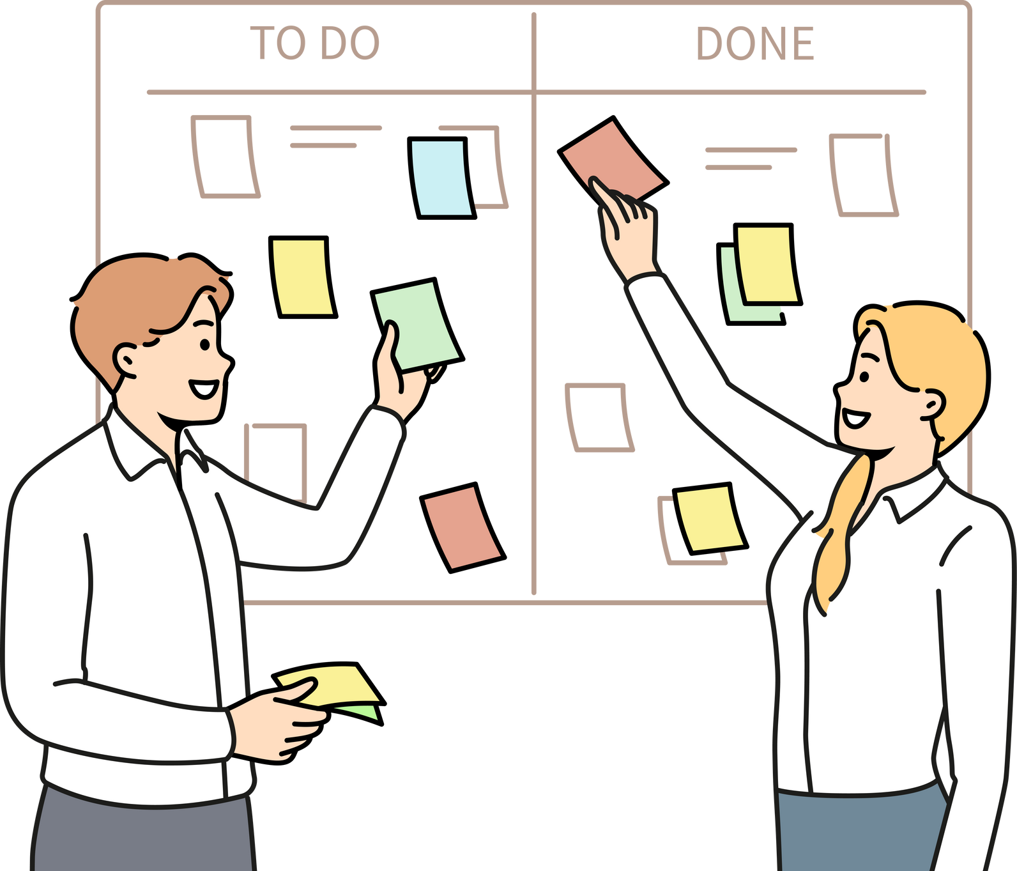
Our Team:
Scrum Master : Saba Atia
Product Owner: Buthena AL-Mazanah
Developer : Rawan Abu Hammad
Developer : Ahmad AL-Shamilh
Developer : Sedra Wael

Slide 4
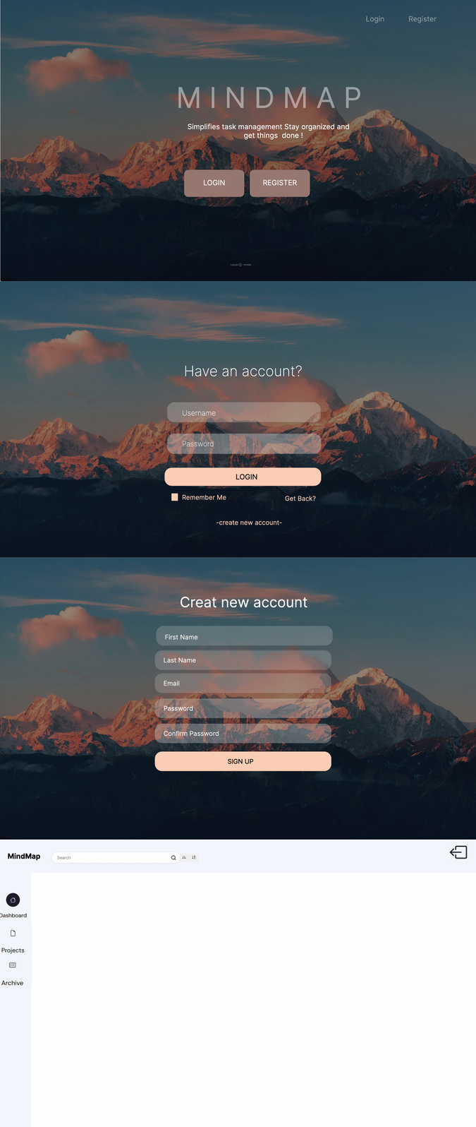
Figma:

